Slide 1

Auto Insurance Churn
Presented by Sylvain MBONGO & Weidong SUN

Slide 2
AGENDA
Introduction
Data Collection and Preparation
Churn Analysis Methodology
Findings and Insights
Recommendations and Conclusion

Slide 3
Introduction
Auto insurance companies in Alberta will likely find themselves in a tight spot.
Alberta Government seeks to lower insurance rates to address cost-of-living crisis.
Insurance claims are on the rise going out of the pandemic.
Our clients are marketing departments of auto insurance companies.
Acquiring a new customer costs several times more than retaining existing customers.
To retain customers, insurance companies need to do three things:
Understand why clients churn (leave the company),
Predict which clients will churn, and
Try to retain potential churning clients through interventions or campaigns that address the reasons for potential churning.
Notes:
Since the end of the pandemic, we are witnessing a surge in traffic incidents, rise cost of car repair and increase court rewards for traffic injuries. All of these have contributed to a drastic increase of auto insurance claims in Alberta. At the same time, to address the cost-of-living crisis, the Alberta government has recently introduced a policy that limits how much auto insurance providers can increase their rates, specifically for drivers with a “good driving record.” This policy will take effect before the end of 2023. So time is running out. Facing pressures from all sides, auto insurance companies will soon find themselves in tough spot. Understanding the critical importance of data-driven decision making, insurance companies are no doubt to commission data analysis projects with utmost urgency. This is where we can help.

Slide 4
Data Collection and Preparation
Our data is taken from Kaggle. It contains information of more than 1.6 million customers.
https://www.kaggle.com/datasets/merishnasuwal/auto-insurance-churn-analysis-dataset
The pandemic has a huge impact on virtually every business, including auto insurance business.
Fortunately, our data is not affected by the pandemic. This allows us to conduct meaningful predictive analysis on the data.
Our data comes with several anomalies. For instance,
Customers born on a particular date.
Customer with a particular annual income.
Customers with age over 67.
We calculated home market values, defined new Age groups and so on.
Customers over 65 years old are discarded for training purposes. This is an important, consequential decision.

Slide 5
Churn Analysis Methodology
We used three kinds of models.
Logistic Regression
Decision Tree, and
Artificial Neural Networks.
Our goal is to identify key churn drivers and predict potential churners.
Models are assessed based on numerous criteria, such as accuracy, precision and recall. We also consider f1-score and plot the confusion matrix.

Slide 6
Churn Analysis Methodology
For our analysis, we used variables and features such as
Financial information, such as income, annual premium and credit rating.
Residence information, such as home market value, home ownership and length of residence.
Personal information, such as college degree, marital status and children status.
Our model is primarily limited by the number of independent variables that are available.
To improve our models, we would like to include more independent variables such as geographical information, insurance coverage or discount utilization, and customer feedbacks or reviews.

Slide 7
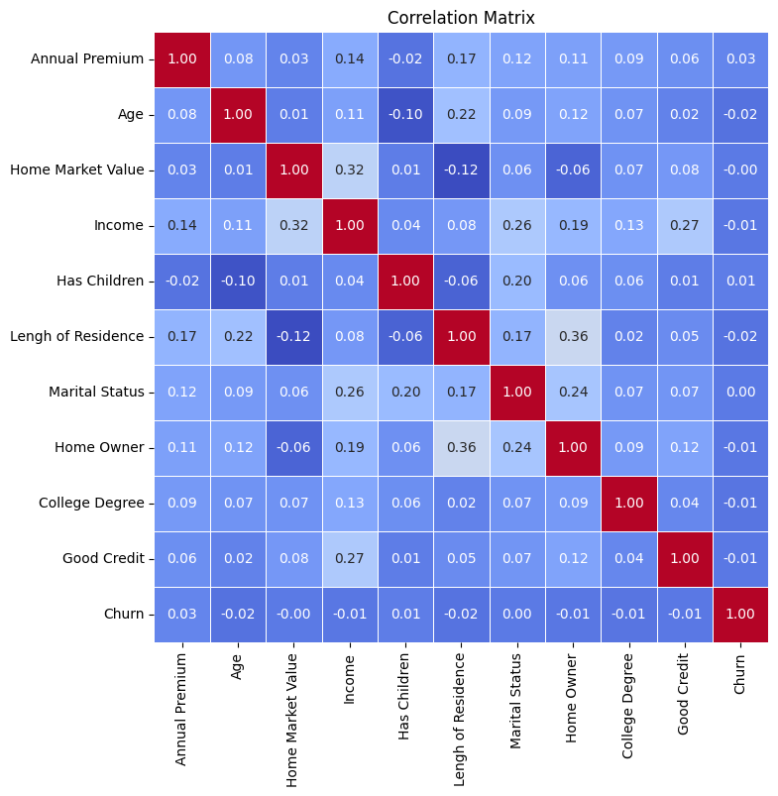
Churn Analysis Methodology
The problem we are facing is an Imbalanced Binary Classification problem, where the data has a majority class and a minority class. In our data, 10% of customers churned, and 90% of customers did not churn.
As a result, typical ML models will predict the churn rate to be 0%. These models are correct 90% of the time because 90% of customers did not churn, but these models are useless.
Furthermore, customer Churn itself is difficult to forecast. The (linear) correlation between Churn and each variable is extremely weak. Thus, typical ways of countering imbalances are also likely to regress to vacuous predictions.

Slide 8
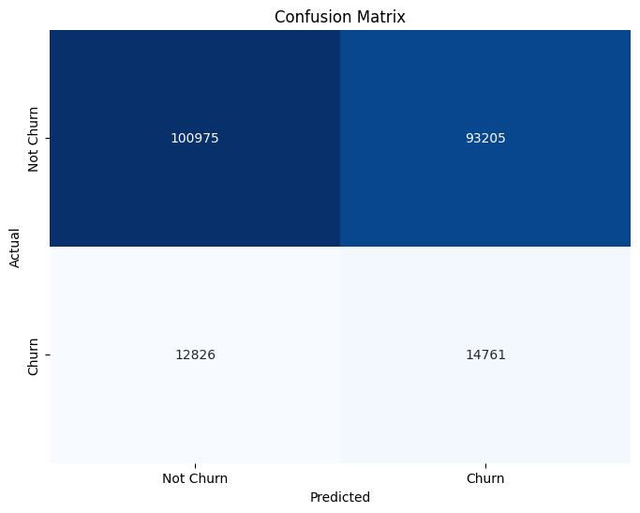
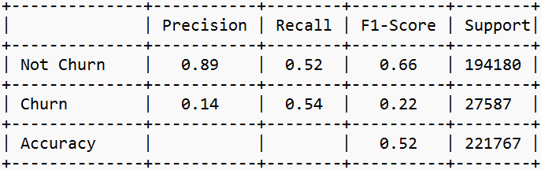
Churn Analysis Methodology – Logistic Regression
Logistic Regression
with SMOTE oversampling
This model identifies a large percentage of churning customers, 54%.

Slide 9
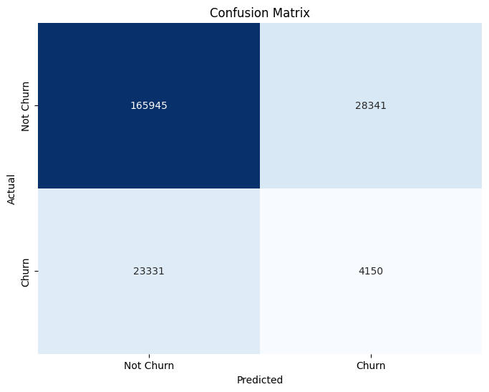
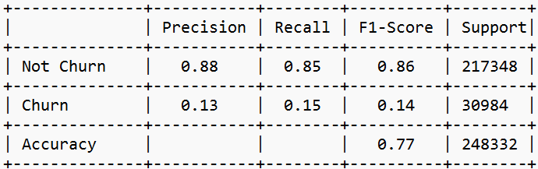
Churn Analysis Methodology – Decision Tree
Decision Tree
with SMOTE oversampling

Slide 10

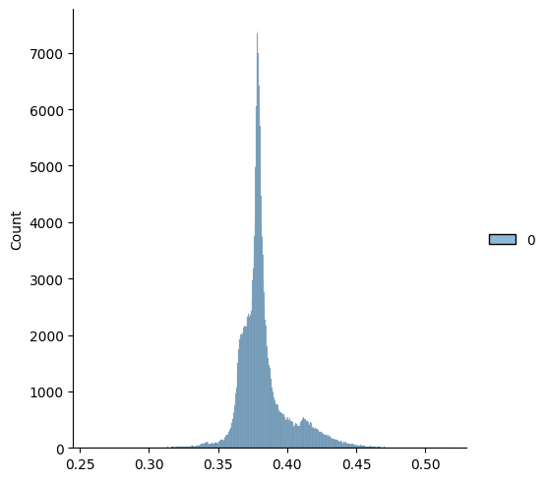
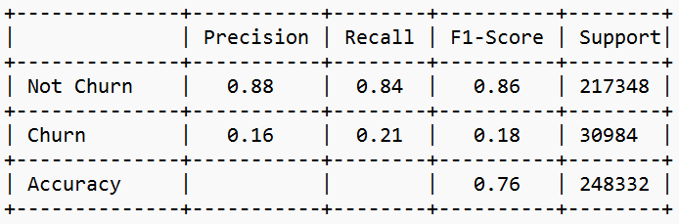
Churn Analysis Methodology – Neural Network
Feedforward Neural Network
without oversampling
using threshold 0.395

Slide 11

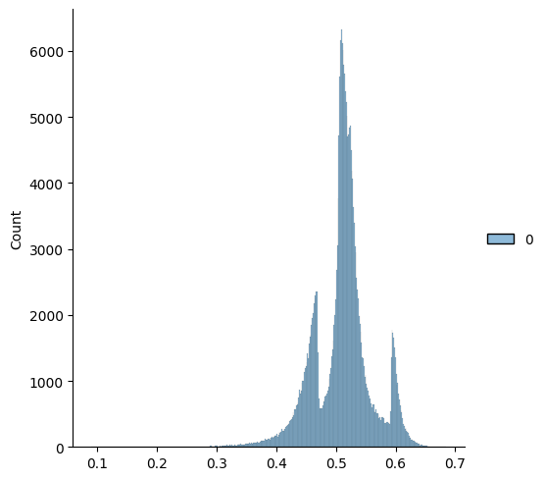
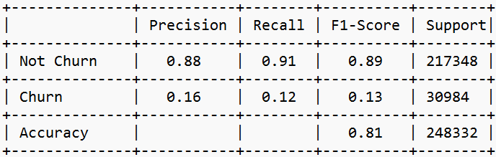
Churn Analysis Methodology – ANN
Feedforward Neural Network
using SMOTE oversampling
slightly different technique
with threshold 0.58

Slide 12
Findings Insights
Business questions:
Are there any patterns or trends in the age groups of customers? Who are more likely to leave the company?
Young people are more likely to churn.
What are the common characteristics of customers who have a higher annual insurance rate or premium?
Customers with higher income pays higher premiums and are less likely to leave the company.
Notes:
More expensive cars cost more to repair. Their insurance rates are higher as a result.

Slide 13
Recommendations and Conclusion
One approach marketing department in an insurance company should take is to provide the best possible customer service in each of their interactions with their clients.
Another strategy is to convince customers to remain as clients when they call to cancel their policies, employing discounts on their premiums or additional benefits.
Implement loyalty points which can be converted to store credits at certain stores.

